Slide 1

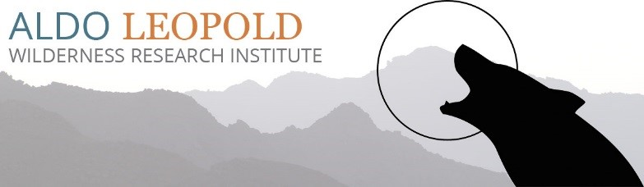

Quantifying Multivariate Fire-Regime Departure across Western US Wilderness Areas
By: Jeffrey Chandler
Solomon Z. Dobrowski
C. Alina Cansler
Zachary L. Steel
Sean A. Parks
Notes:
Hello Everyone. I’m Jeffrey Chandler and I’m currently a Master’s student at University of Montana under Solomon Dobrowski and Sean Parks and Alina Cansler. Zach Steel helped with conceptualizing this project. This presentation is on quantifying the multivariate fire-regime departure across western US Wilderness Areas. To begin…

Slide 2
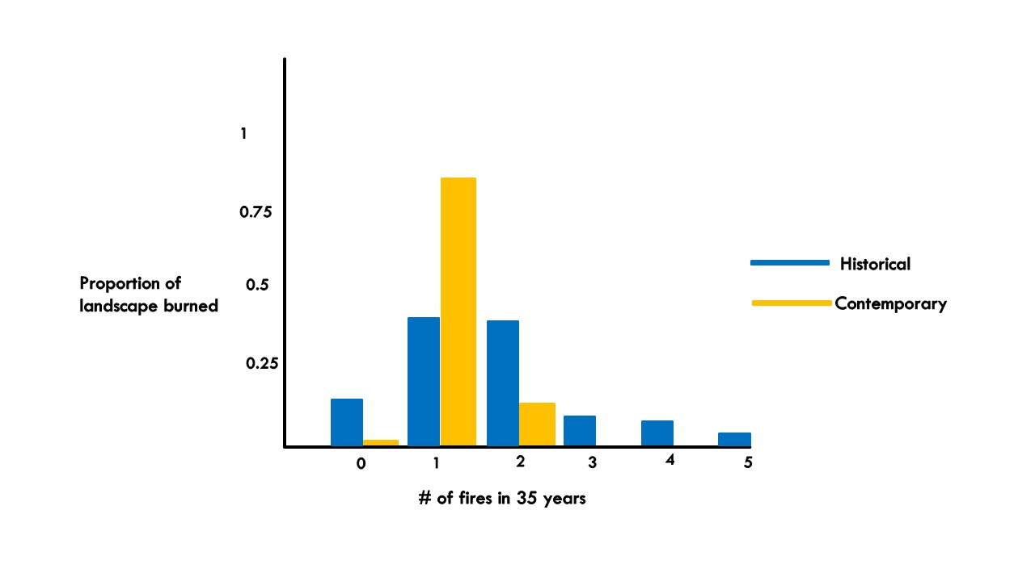
Over a 35-year period
Contemporary fires
Historical fires
# of Fires
After 100+ years of Fire Exclusion
5
4
3
2
1
0
Density of Fire Severity
Notes:
We all know that fire regimes are changing across the western US as a result of fire-exclusion due to European settlement. In many ecosystems we are seeing the simplification of fire-regime traits such as fire frequency and fire severity, such as our example, and this simplification affects ecosystem structure and function. If we want to describe the fire regime, we can sample the landscape and plot fire frequencies for the historical and contemporary periods *click*. For our example, we’d get a result like this, where the historical, in blue, as a much broader distribution compared to the gold contemporary distribution. Usually, we would then calculate a mean fire frequency or a mean fire return interval, however, in this case, the mean actually does not change *click*. Our current measures don’t capture the simplification of fire regimes, and these distributions are what ultimately drive ecosystem complexity, so with that *click*

Slide 3
We developed a method to measure distributional changes in fire-regimes
Notes:
We developed a method to measure distributional changes in fire-regimes and we are showing a proof of concept of our method using fire frequency and fire severity*click*

Slide 4
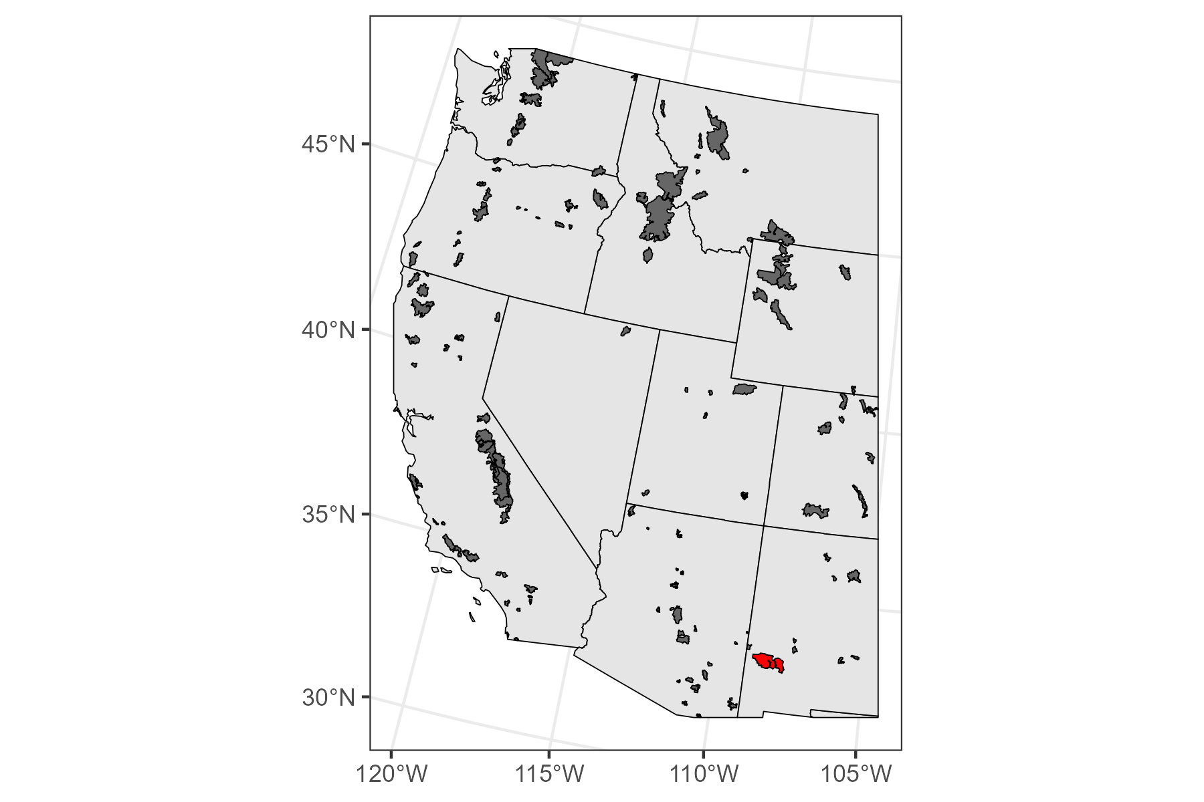
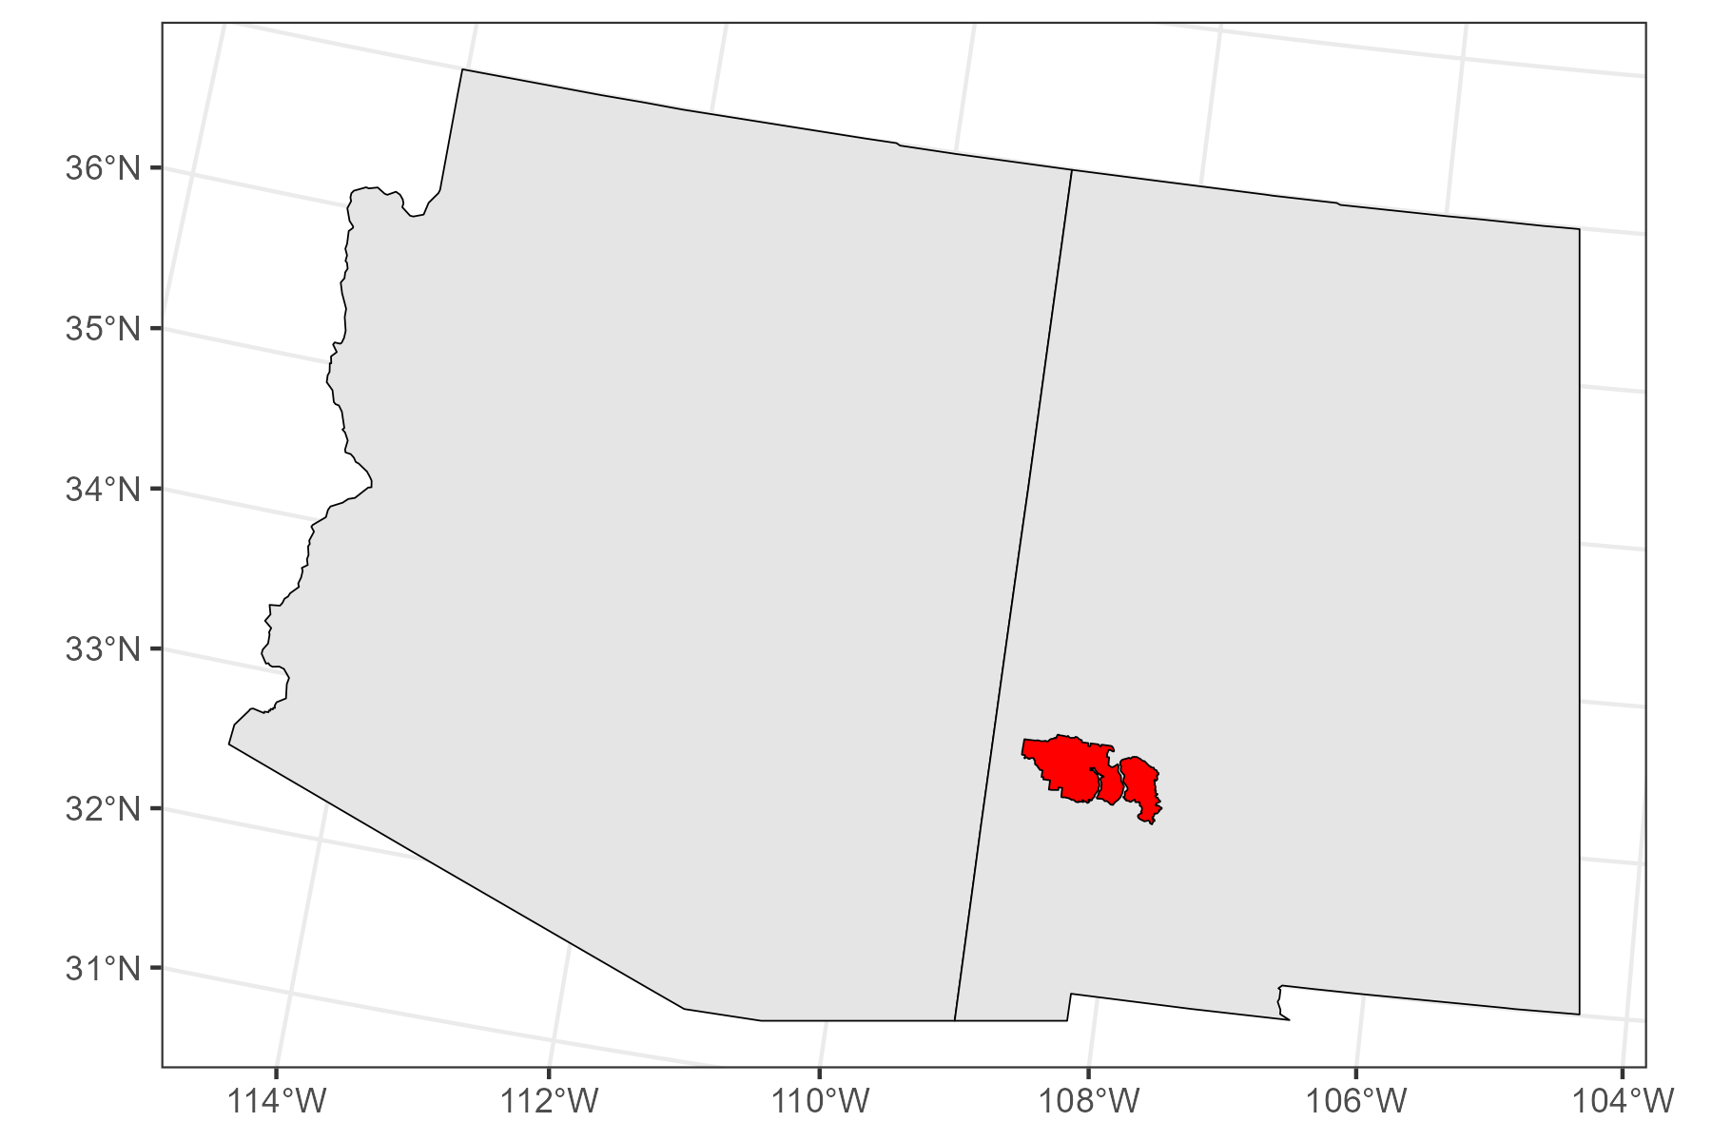
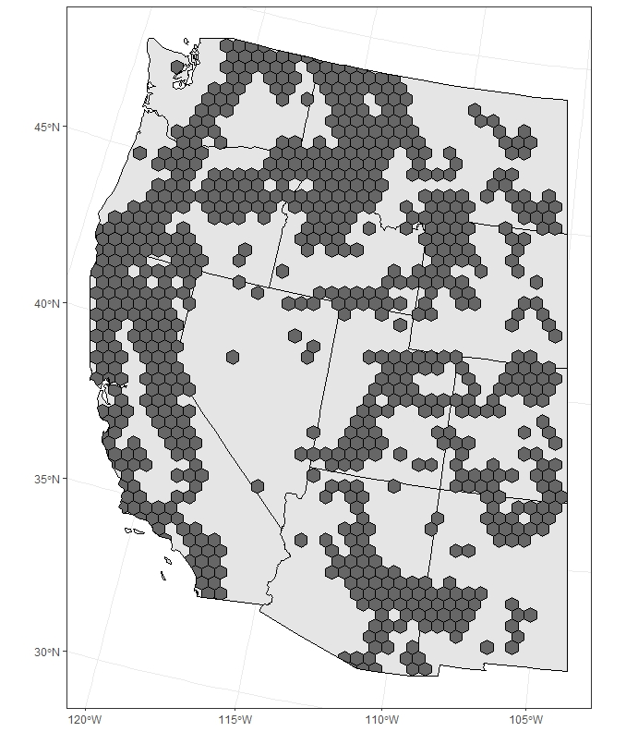
Study Area
Aldo Leopold
Gila
We are studying the western US
Notes:
Our main study area was a hex grid that contained burned forests, but *click* we also studied wilderness areas. To help illustrate our methods, I will use a vignette of the *click* Gila and Aldo Leopold wilderness areas because *click*

Slide 5
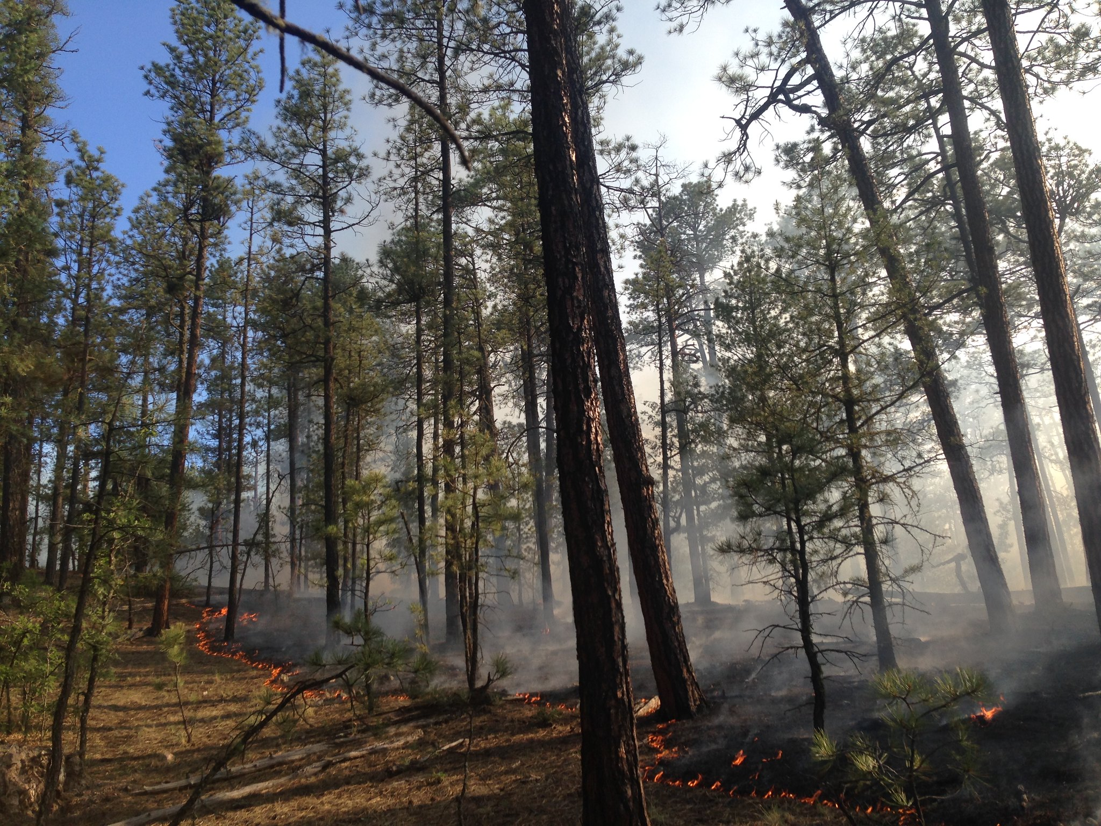
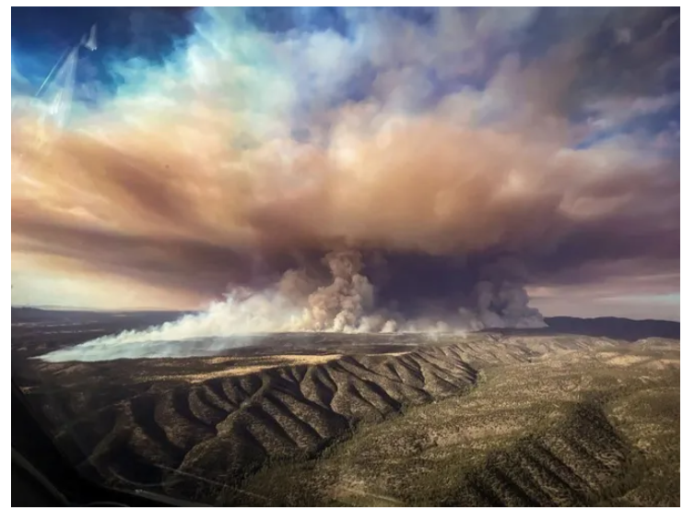
Credit: Good Fire Photos Public Domain
Credit: National Wildfire Coordinating Group Public Domain
Notes:
They are both wilderness areas that are very similar in climate, vegetation, and overarching management. These wilderness areas should burn like the photo from the Gila wilderness on the left, frequent, low severity. However *click*, the Aldo Leopold wilderness is experiencing fires like those on the right, infrequent, high severity fires. So, to begin our methods, we need to characterize the contemporary fire-regime. *click*

Slide 6
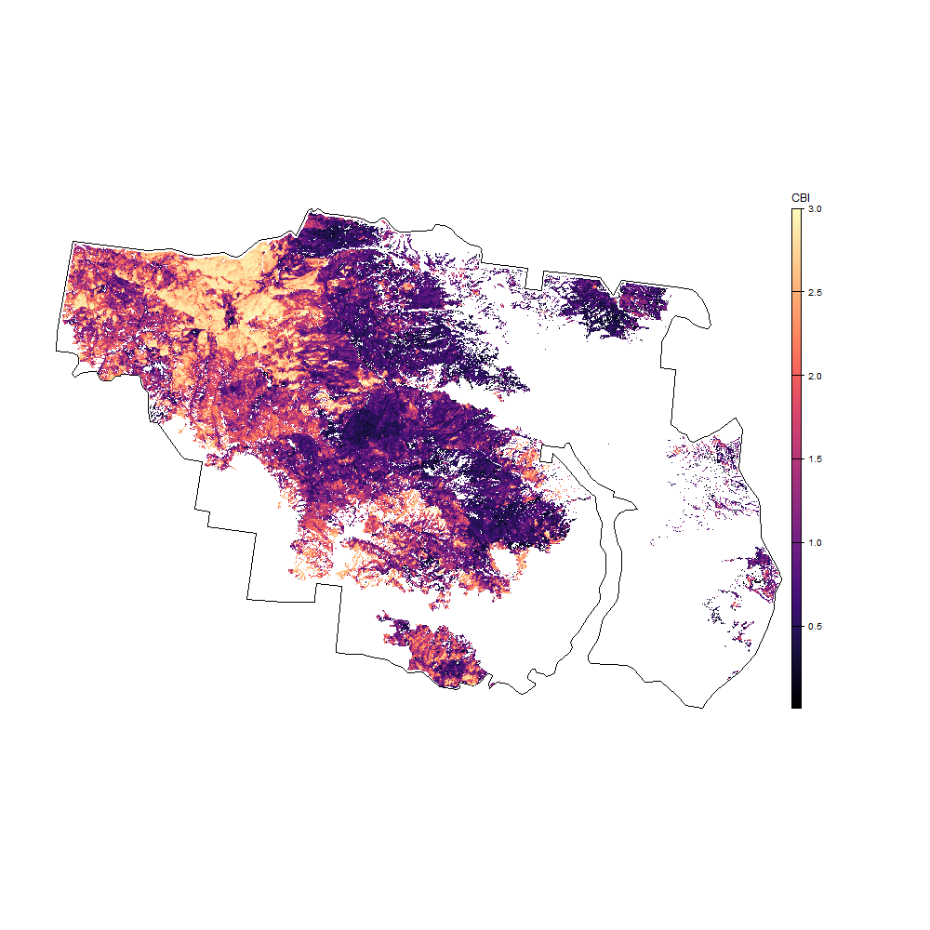
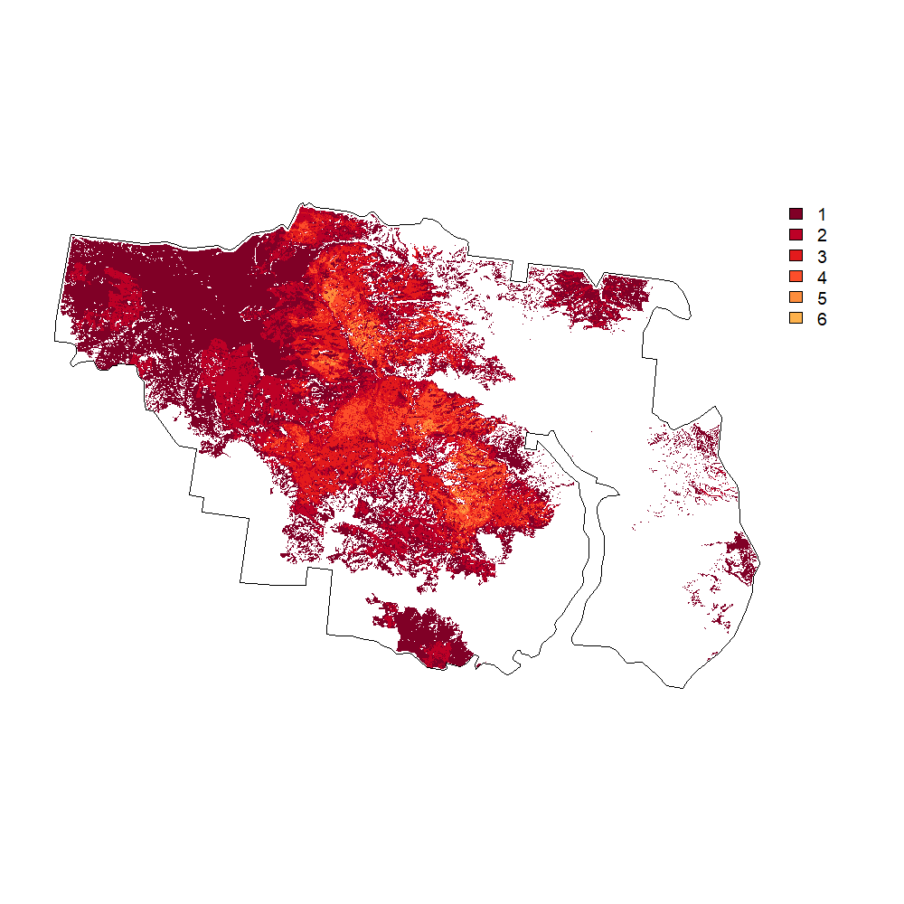
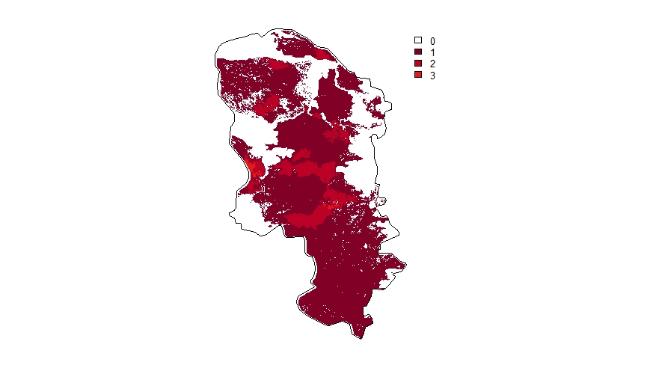
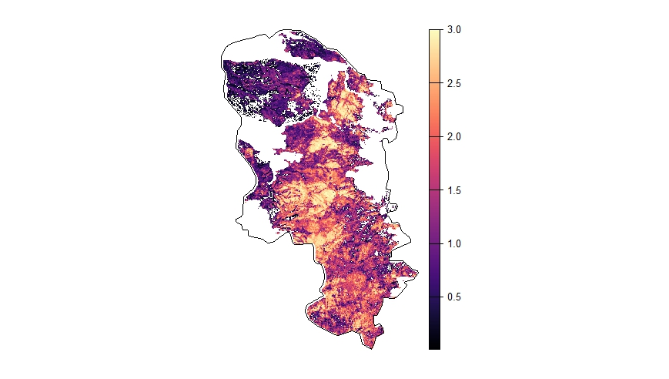
Contemporary Fire-Regime
We can extract
Fire Frequency
Fire Severity*
Methods
Notes:
We can use remotely sensed data at 30m resolution to directly extract fire frequency *click* and fire severity *click*. We then sample from these landscapes and convert them into distributions to generate contemporary fire frequency and severity distributions, which, for the Gila, looks like this *click*

Slide 7
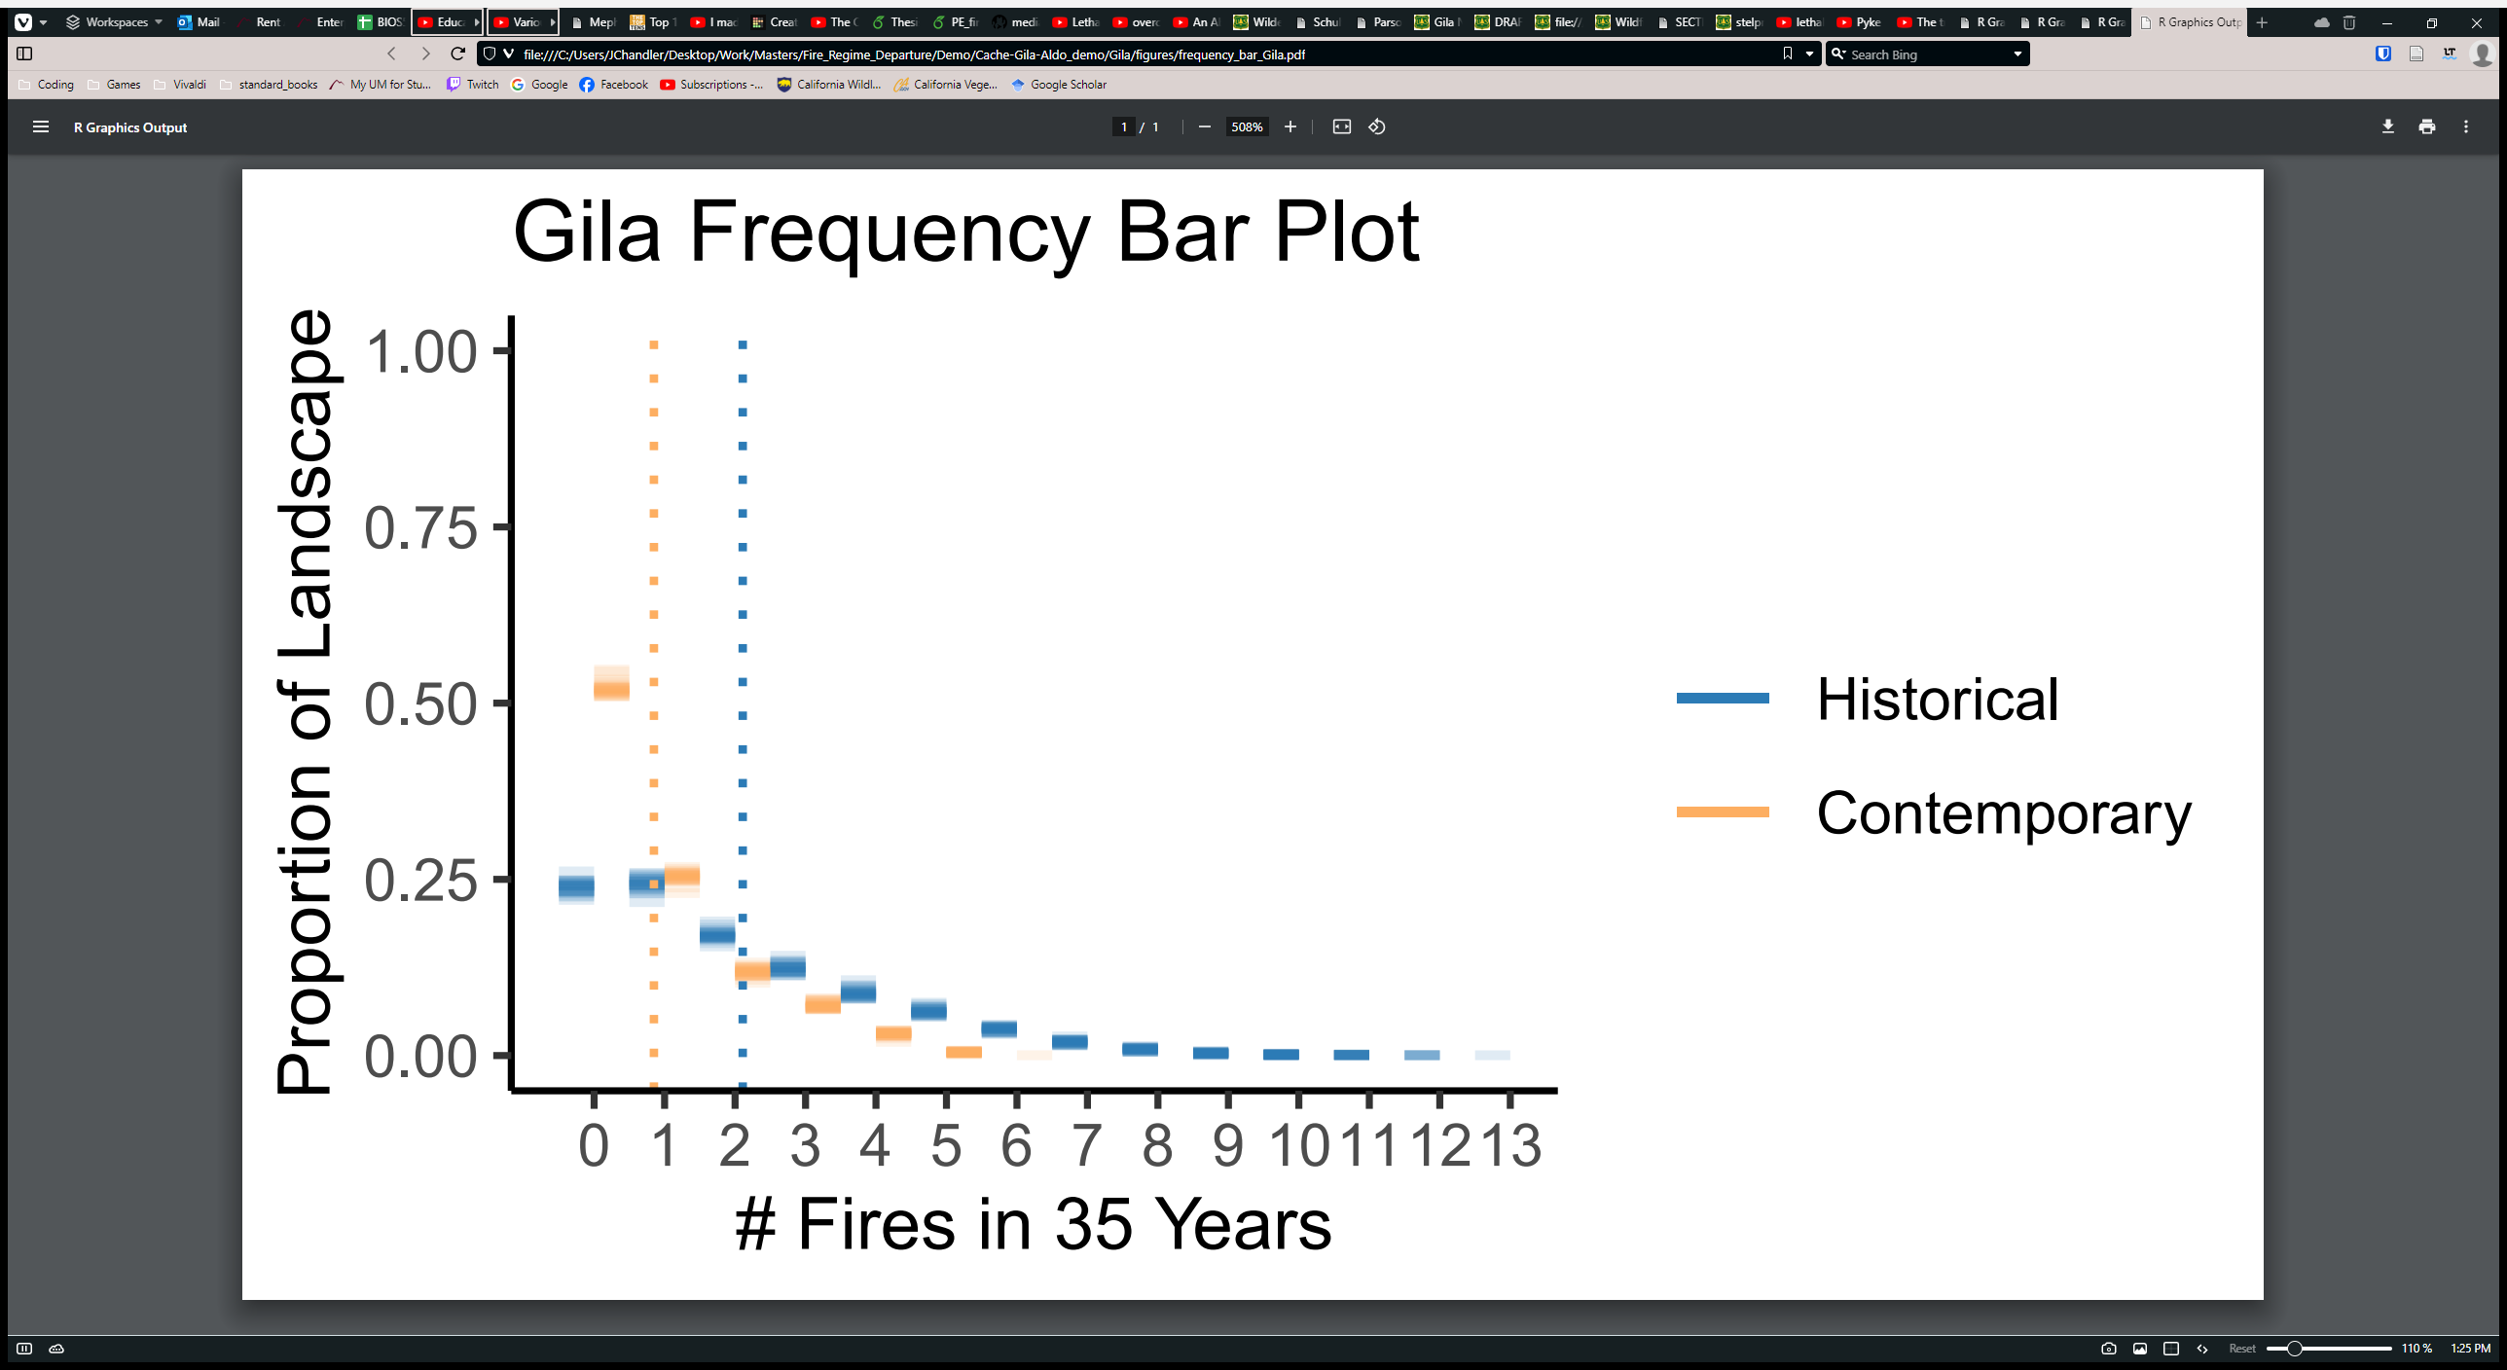
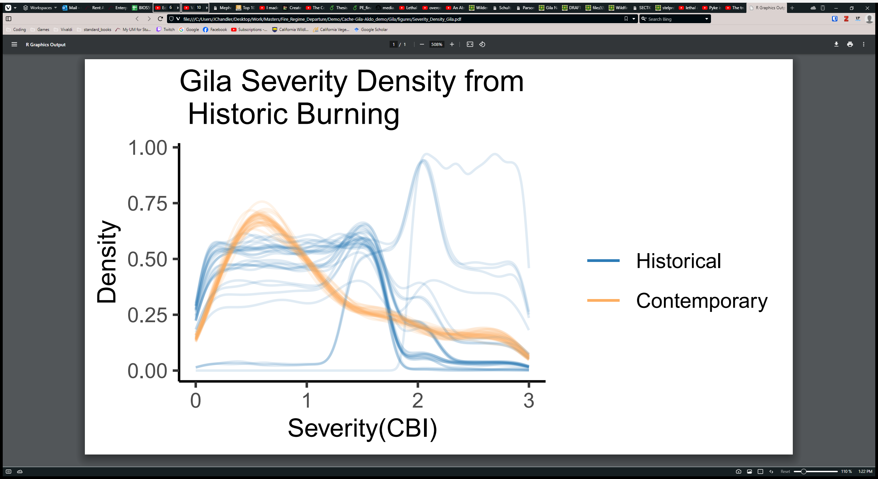
Fire Frequency
Gila Wilderness
Fire Severity
Methods
Notes:
*pause* With this, we now need to develop the historical distributions of fire frequency and severity *click*

Slide 8
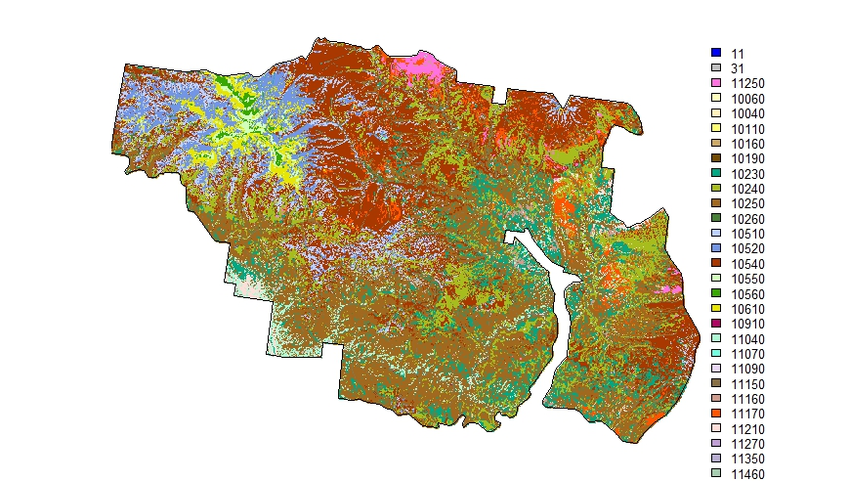
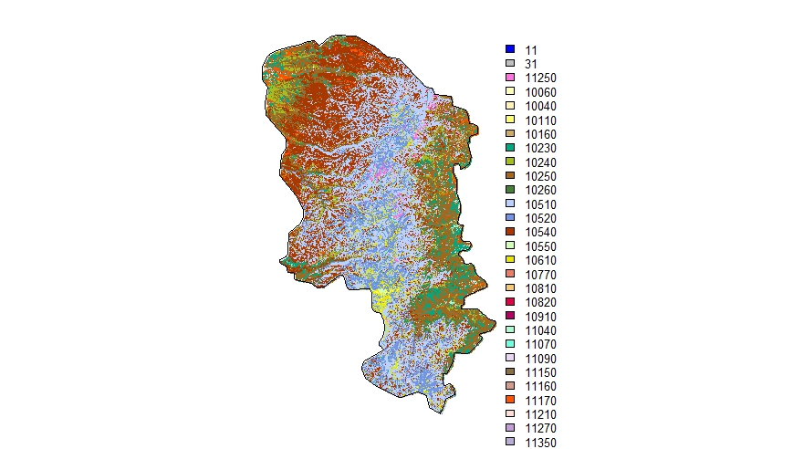
Historical Fire-Regime
Fire Frequency and Severity (Using BioPhysical Setting; LANDFIRE, 2020)
Modeled pre-European settlement vegetation
Includes fire-regime models to enable simulations
Methods
Notes:
We decided to simulate historical fire frequency and severity using LANDFIRE BioPhysical setting. Each color has a modeled pre-European settlement vegetation type, which are paired with fire regime models that we can compare with contemporary remotely sensed data. To capture simulation variation, we sampled and simulated 100 times in each landscape. We take our simulation data and convert it to distributions, which we can see for both of our wilderness areas here *click*

Slide 9
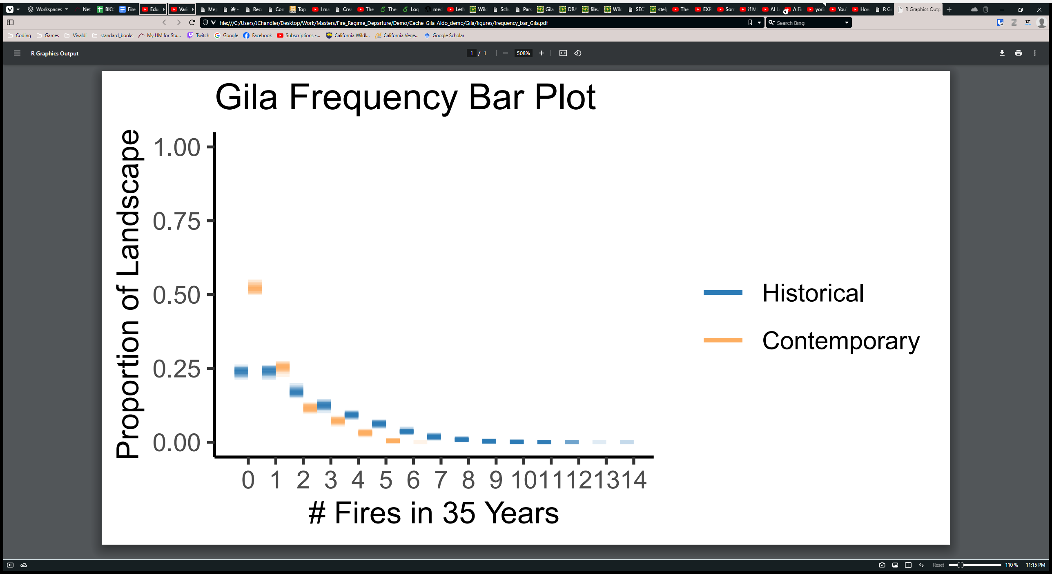
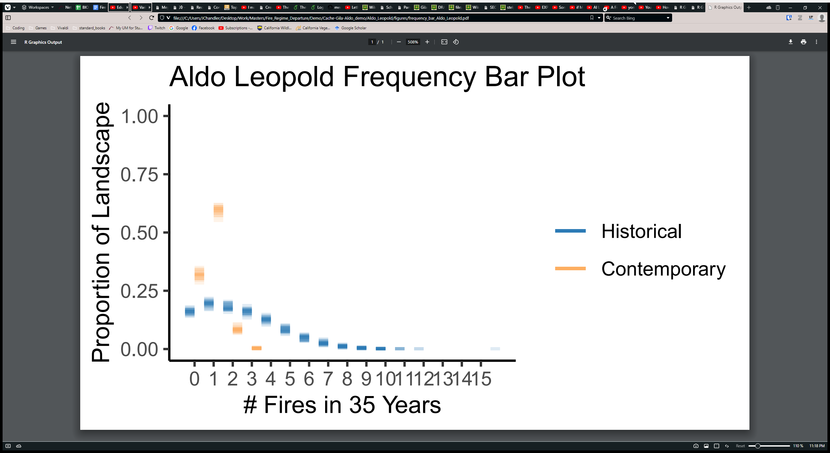

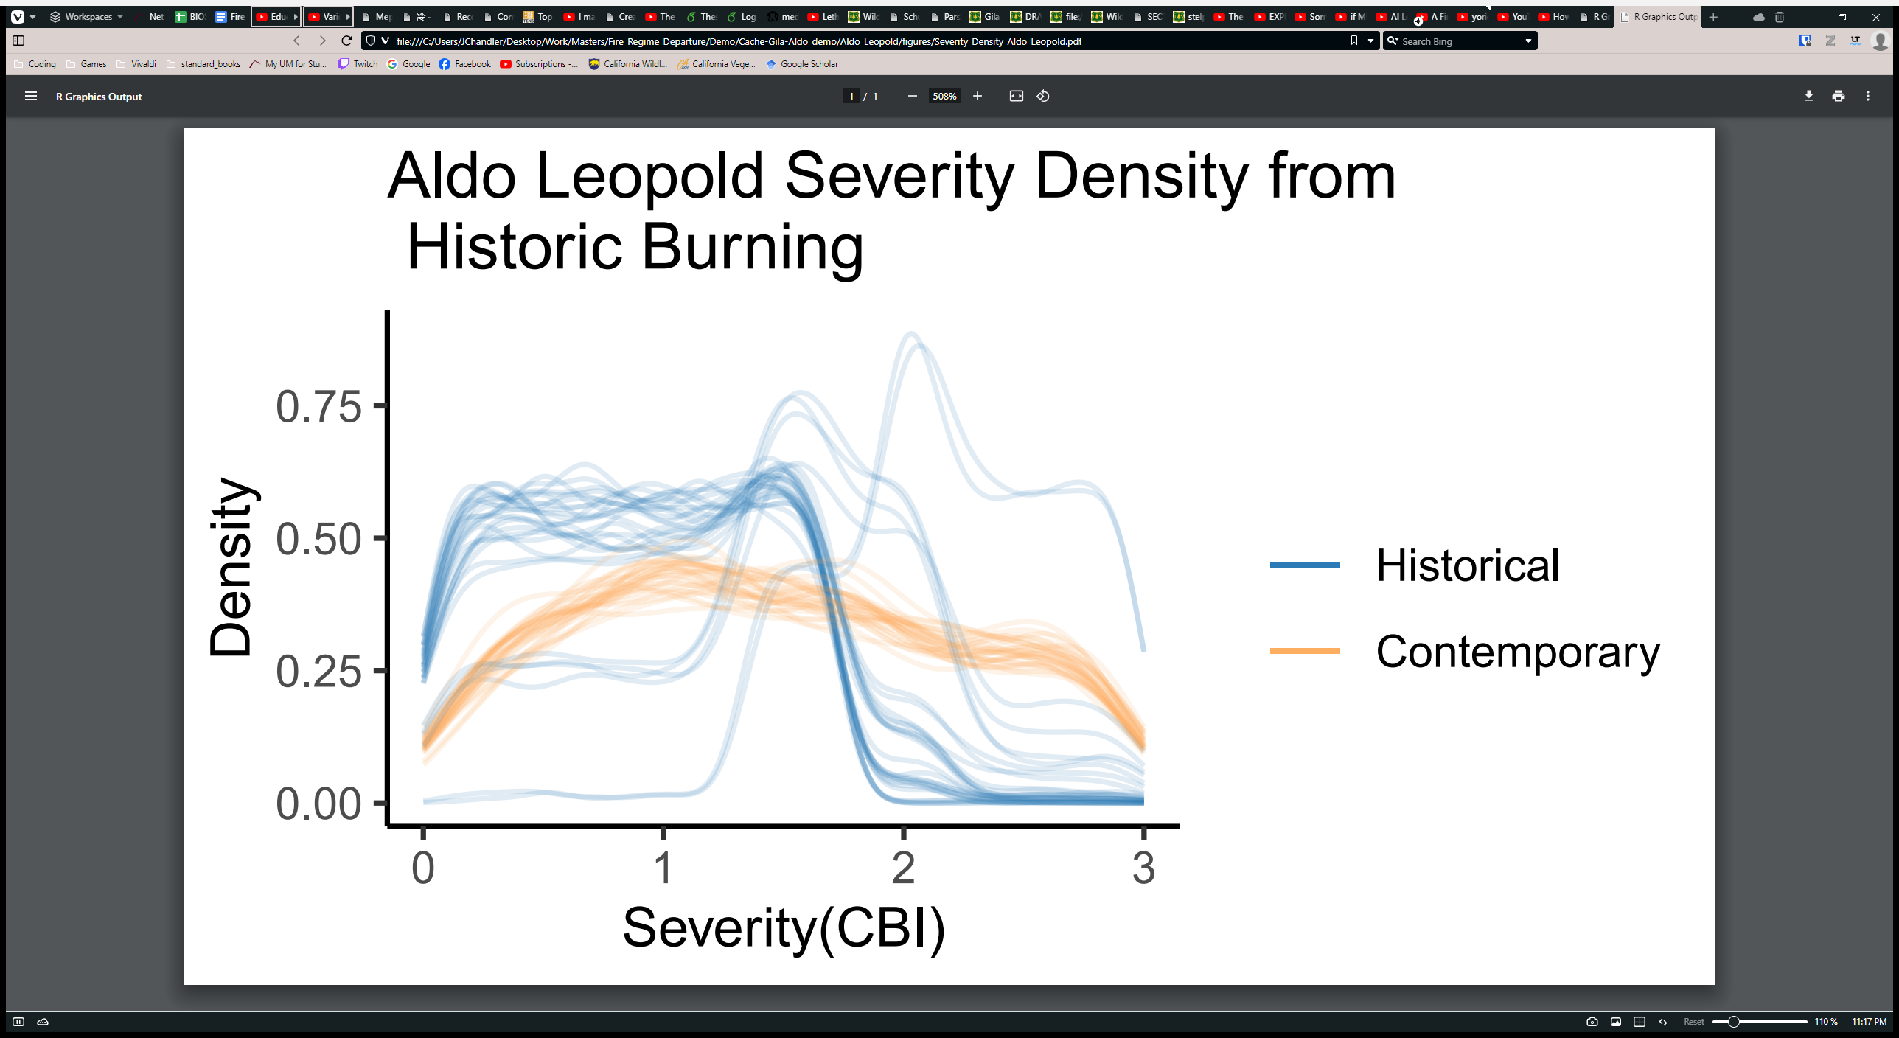
Fire Frequency
Gila Wilderness
Aldo Leopold Wilderness
Fire Severity
Methods
Notes:
Each fuzzy line is a simulation run. Gila on the left, Aldo Leopold on the right, blue is historical, gold is contemporary. Looking at fire frequency, we can see the spread of data in the Gila is far more like the historical simulations, meanwhile the Aldo Leopold is showing a far narrower range in the contemporary fire frequencies. And if we look at fire severity *click* similar trends persist. While simulations differ more, in general the Gila is closer to the historical simulations than the Aldo Leopold. Now that we have these distributions *click*

Slide 10
Contemporary
Historical
Fire Frequency
Extract
Simulate
Fire Severity
Fire Frequency
Remotely Sensed CBI
Fire Severity
BioPhysical Setting
How do we quantify the differences in these distributions?
Convert to Distributions
Convert to Distributions
Contemporary Distributions
Earth Mover’s Distance
Historical Distributions
Fire Frequency Departure
Fire Severity Departure
Fire-Regime Departure
Index
Methods
Notes:
How do we quantify the differences in these distributions? *click* We chose to use the Earth Mover’s Distance, which is a nonparametric statistic that quantifies the difference between two distributions *click*. Where we can capture changes in fire-regimes like this *point to distributions*. Now, because we simulated fire frequency independently from fire severity, we computed Earth Mover’s distance on each attribute to get a departure in each attribute, which were combined into a fire-regime departure metric. Now we can get into results! First, west wide *click*

Slide 11
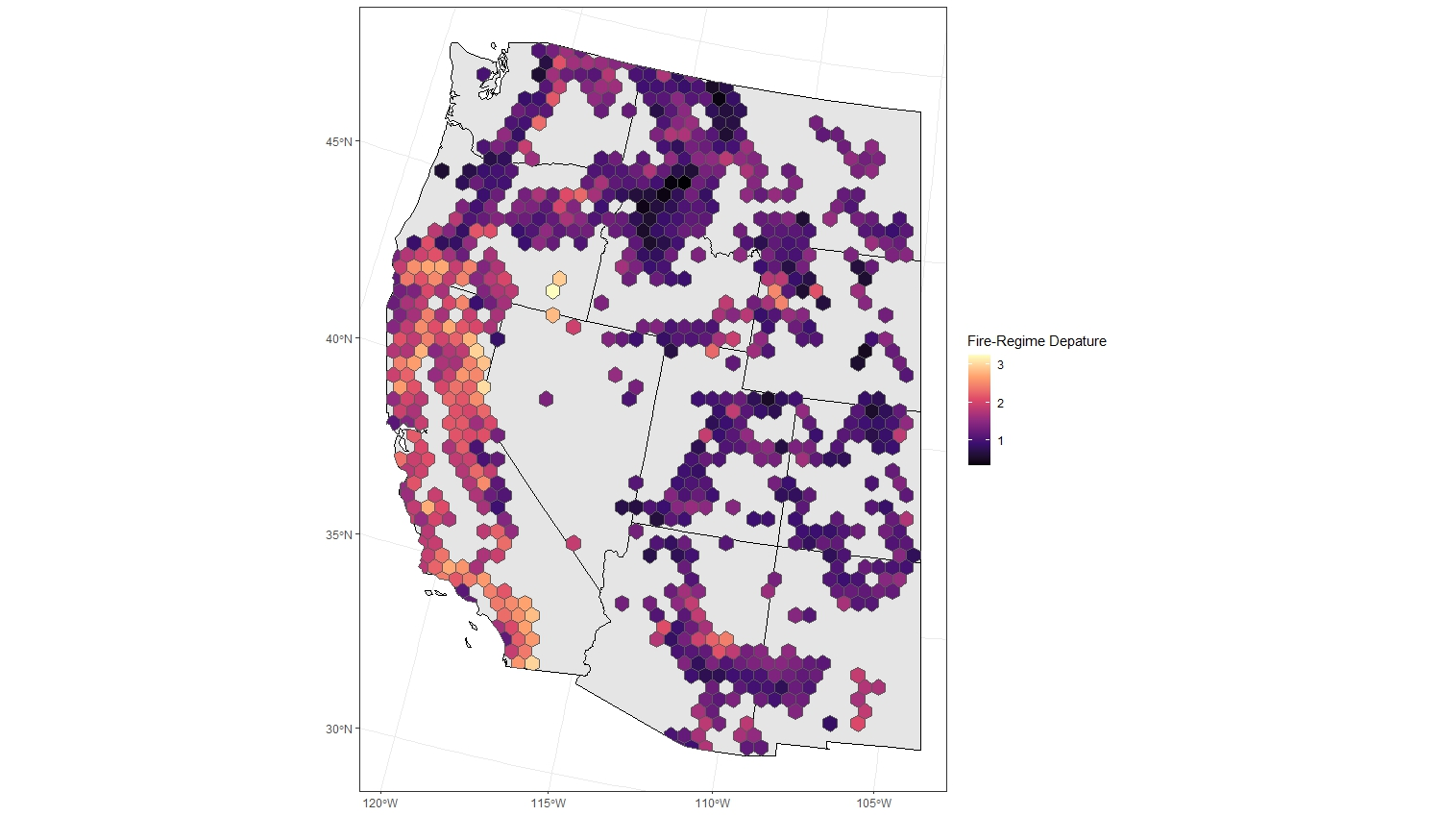
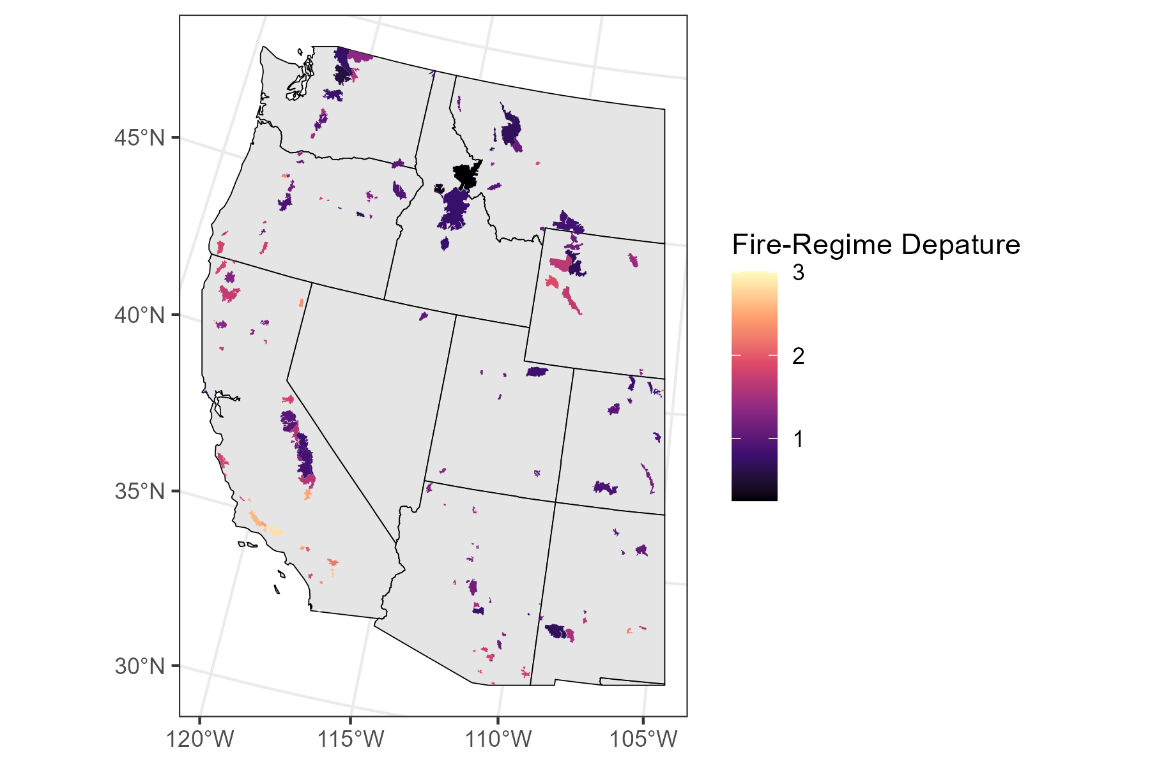
Our Fire-Regime Departure
Most high departures are in California
Most low departures are in Idaho and Montana
West-wide
Results
Notes:
*pause*We can look at how our fire regime departure index is distributed spatially, which *click* California is clearly more departed than most other places in the west, and that the least departed states appear to be Idaho and Montana. We can apply the same methods to wilderness areas. *click*

Slide 12
Our Fire-Regime Departure
Wildernesses show similar trends
Wilderness
Results
Notes:
*pause*We see the same patterns, albeit less strongly. Now, because our index combines independent departures in fire frequency and fire severity, we can look at how fire frequency and severity of western US wilderness areas are changing. *click*

Slide 13
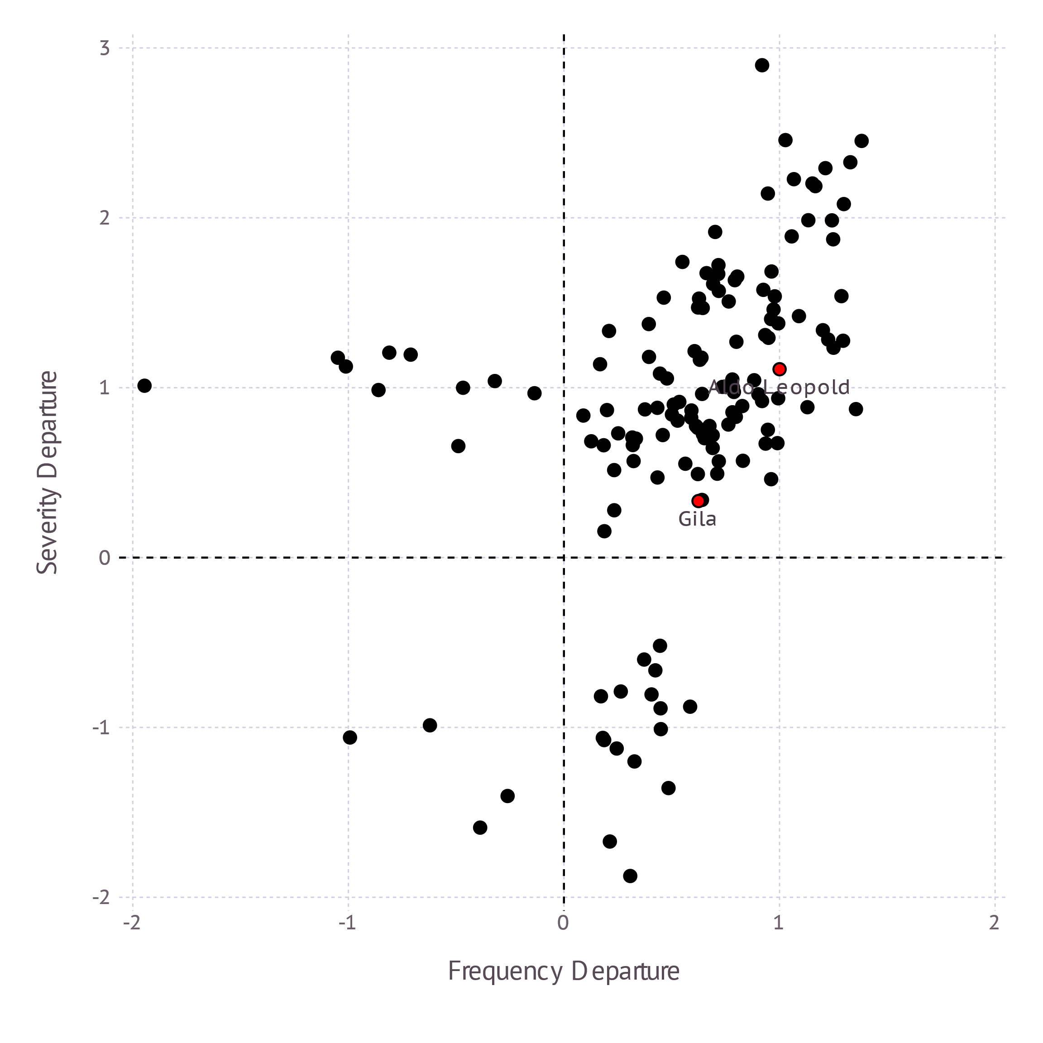
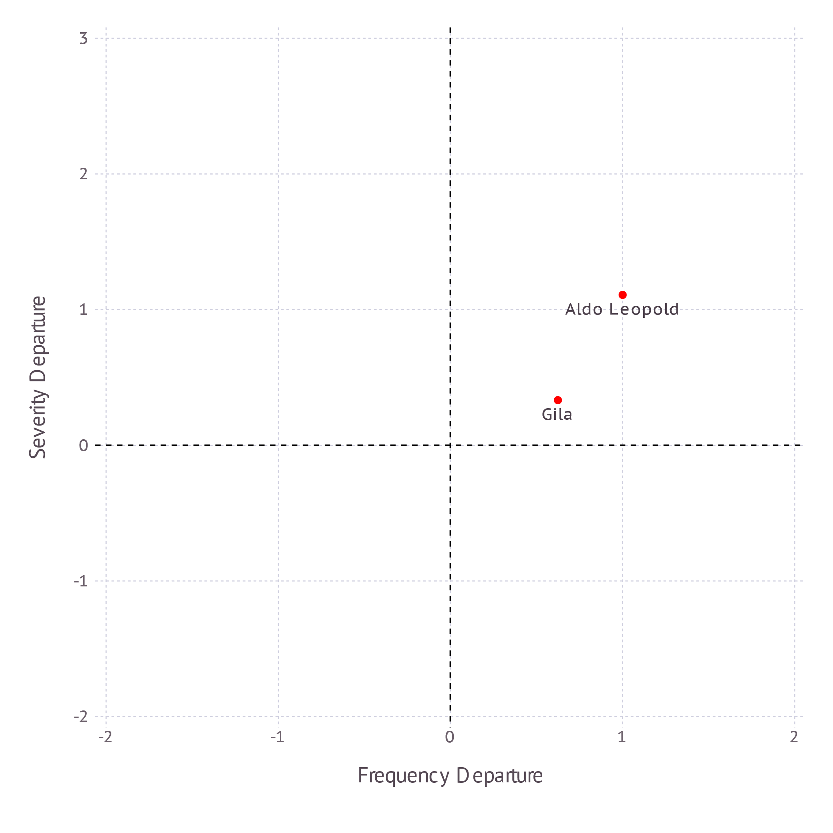
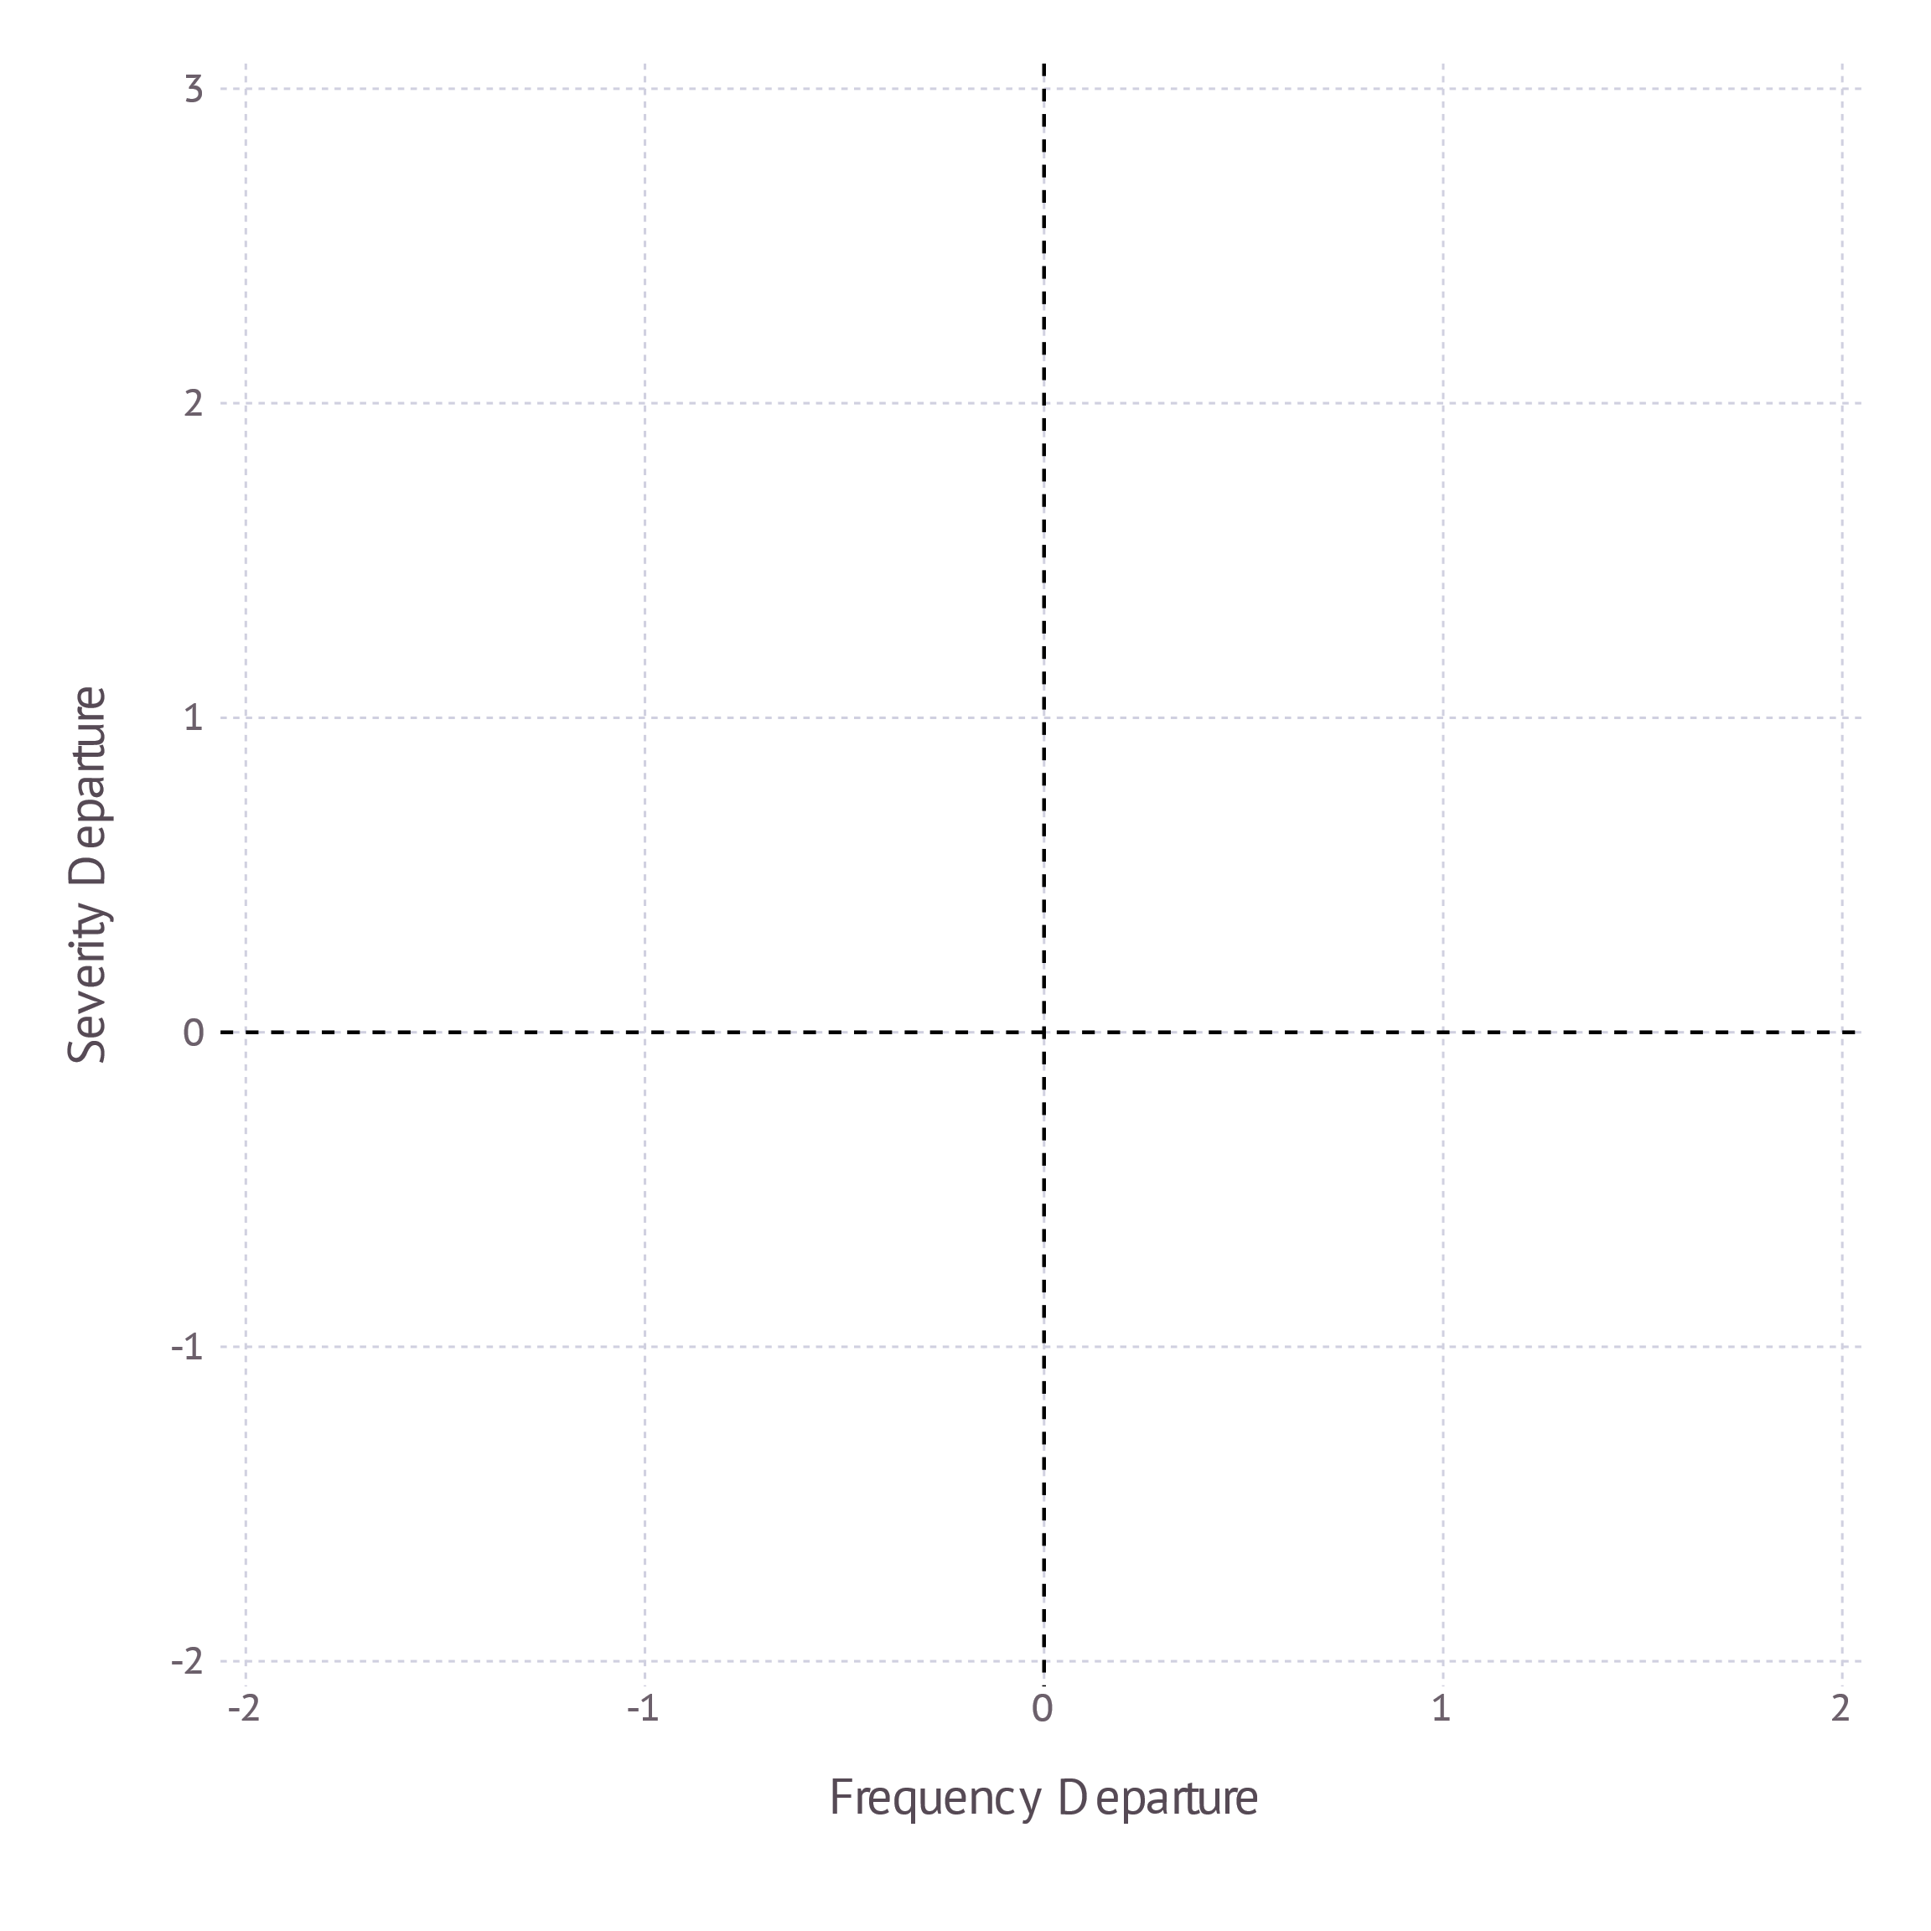
How are fire-regimes changing?
More Frequent
More Severe
Less Frequent
More Severe
Most wildernesses are burning less frequently, more severely.
Our Severity Departure
More Frequent
Less Severe
Less Frequent
Less Severe
Wilderness
Results
Our Frequency Departure
Notes:
The x is our fire frequency metric, and our y is our fire severity metric. Each quadrant represents and labels the net direction of fire frequency and severity. We can see where the aldo leopold and the gila wildernesses fall on this plot *click*.*pause*. And now for every wilderness area *click*. As we can see, barring some exceptions, most wildernesses are burning less frequently, more severely. From these data we have demonstrated our method and how it sees fire-regime departures across the west, from these data, we can make the following conclusisons *click*

Slide 14
Conclusions:
Our metric captures distributional changes
California contains the highest departures
Most wilderness areas are burning less frequently, more severely
Notes:
Our metric captures distributional changes in fire regimes
California contains the highest departures.
And most wilderness areas are burning less frequently, more severely
And with that *click*

Slide 15
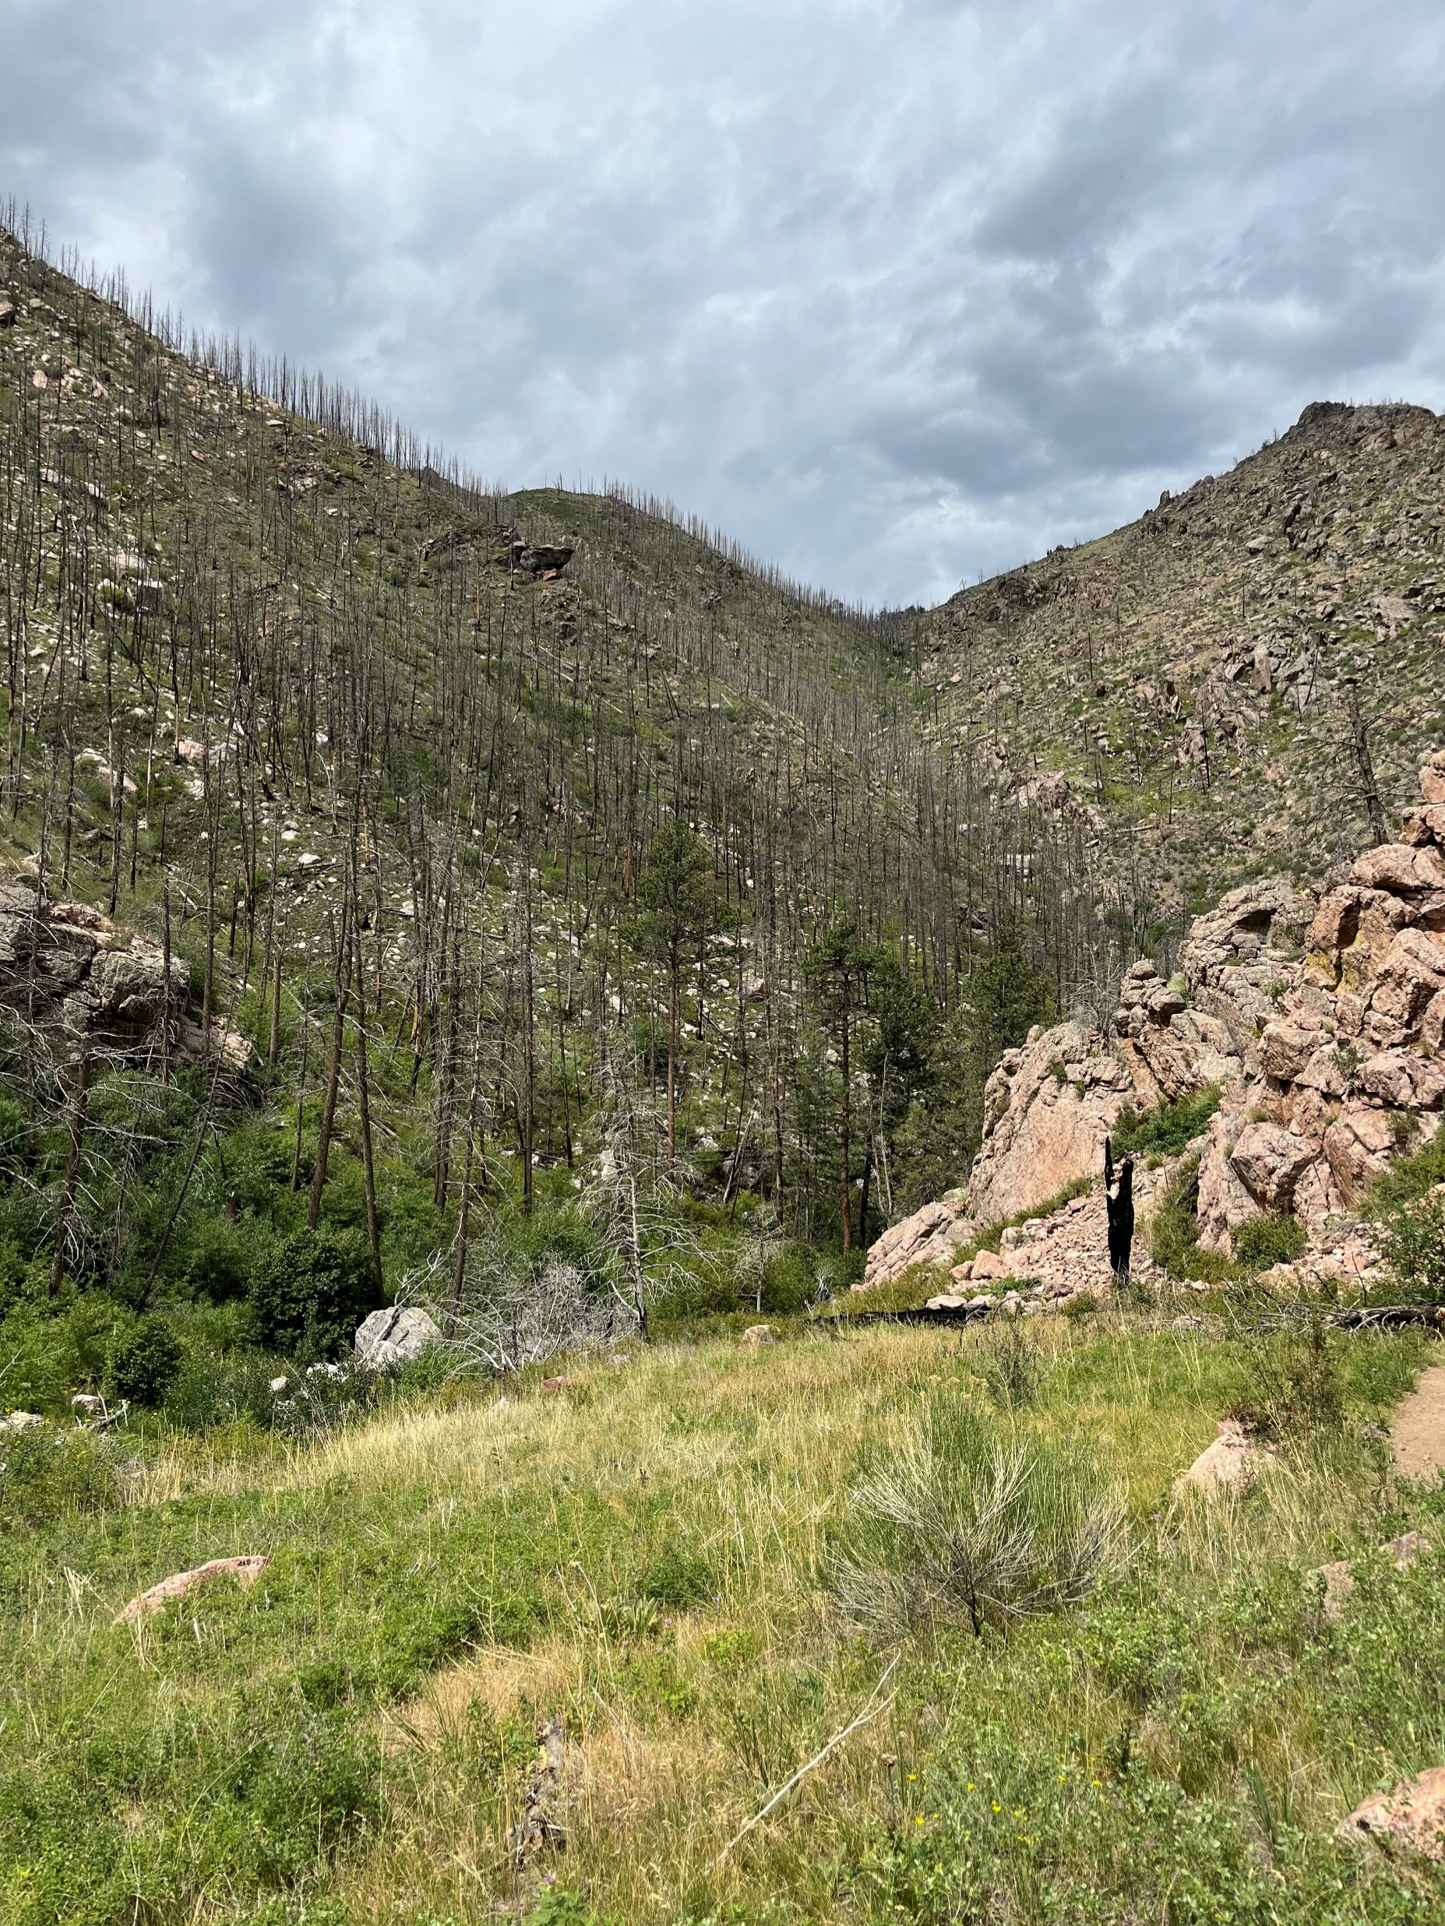
Acknowledgements
Funding: Aldo Leopold Wilderness Institute
Committee: Solomon, Sean, Alina
Conceptual help: Zach, Gavin Jones and Tyler Hoecker
Miscellaneous: I’d like to thank Svetlana Yegorova, the UM writing Center, my brother and my graduate student cohort
Testdisk for recovering this presentation from a corrupted flashdrive
Credit: Sean Parks
Notes:
I would like to thank the Aldo Leopold wilderness institute for funding this project. Solomon, Sean and Alina for being on my committee, Zach, Gavin Jones, and Tyler Hoecker for help with the major concepts and motivations. And I’d like to generally thank lab mate Svetlana, the UM writing Center, my brother, and my graduate student cohort for various places of advice, help, and community. *click*

Slide 16
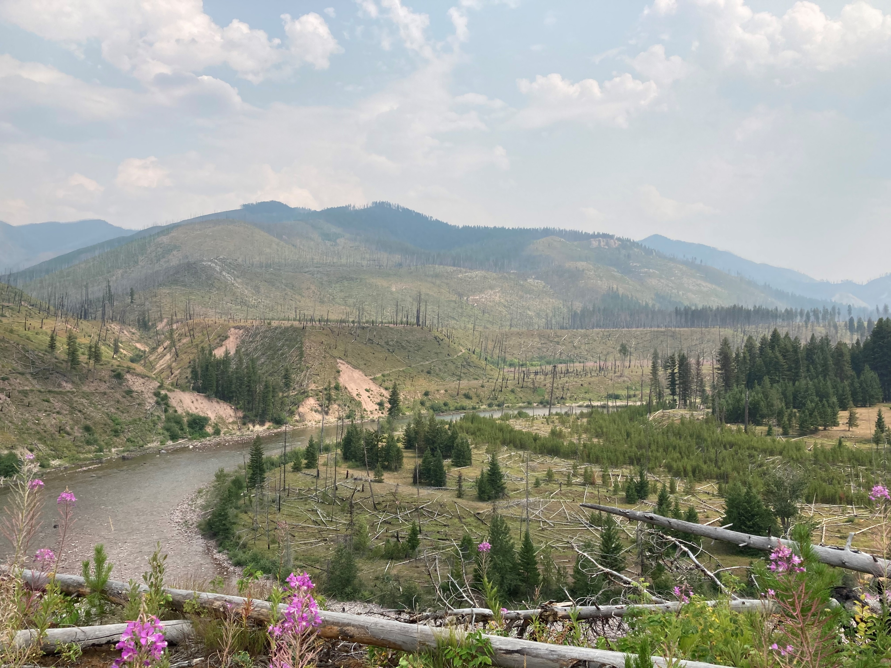
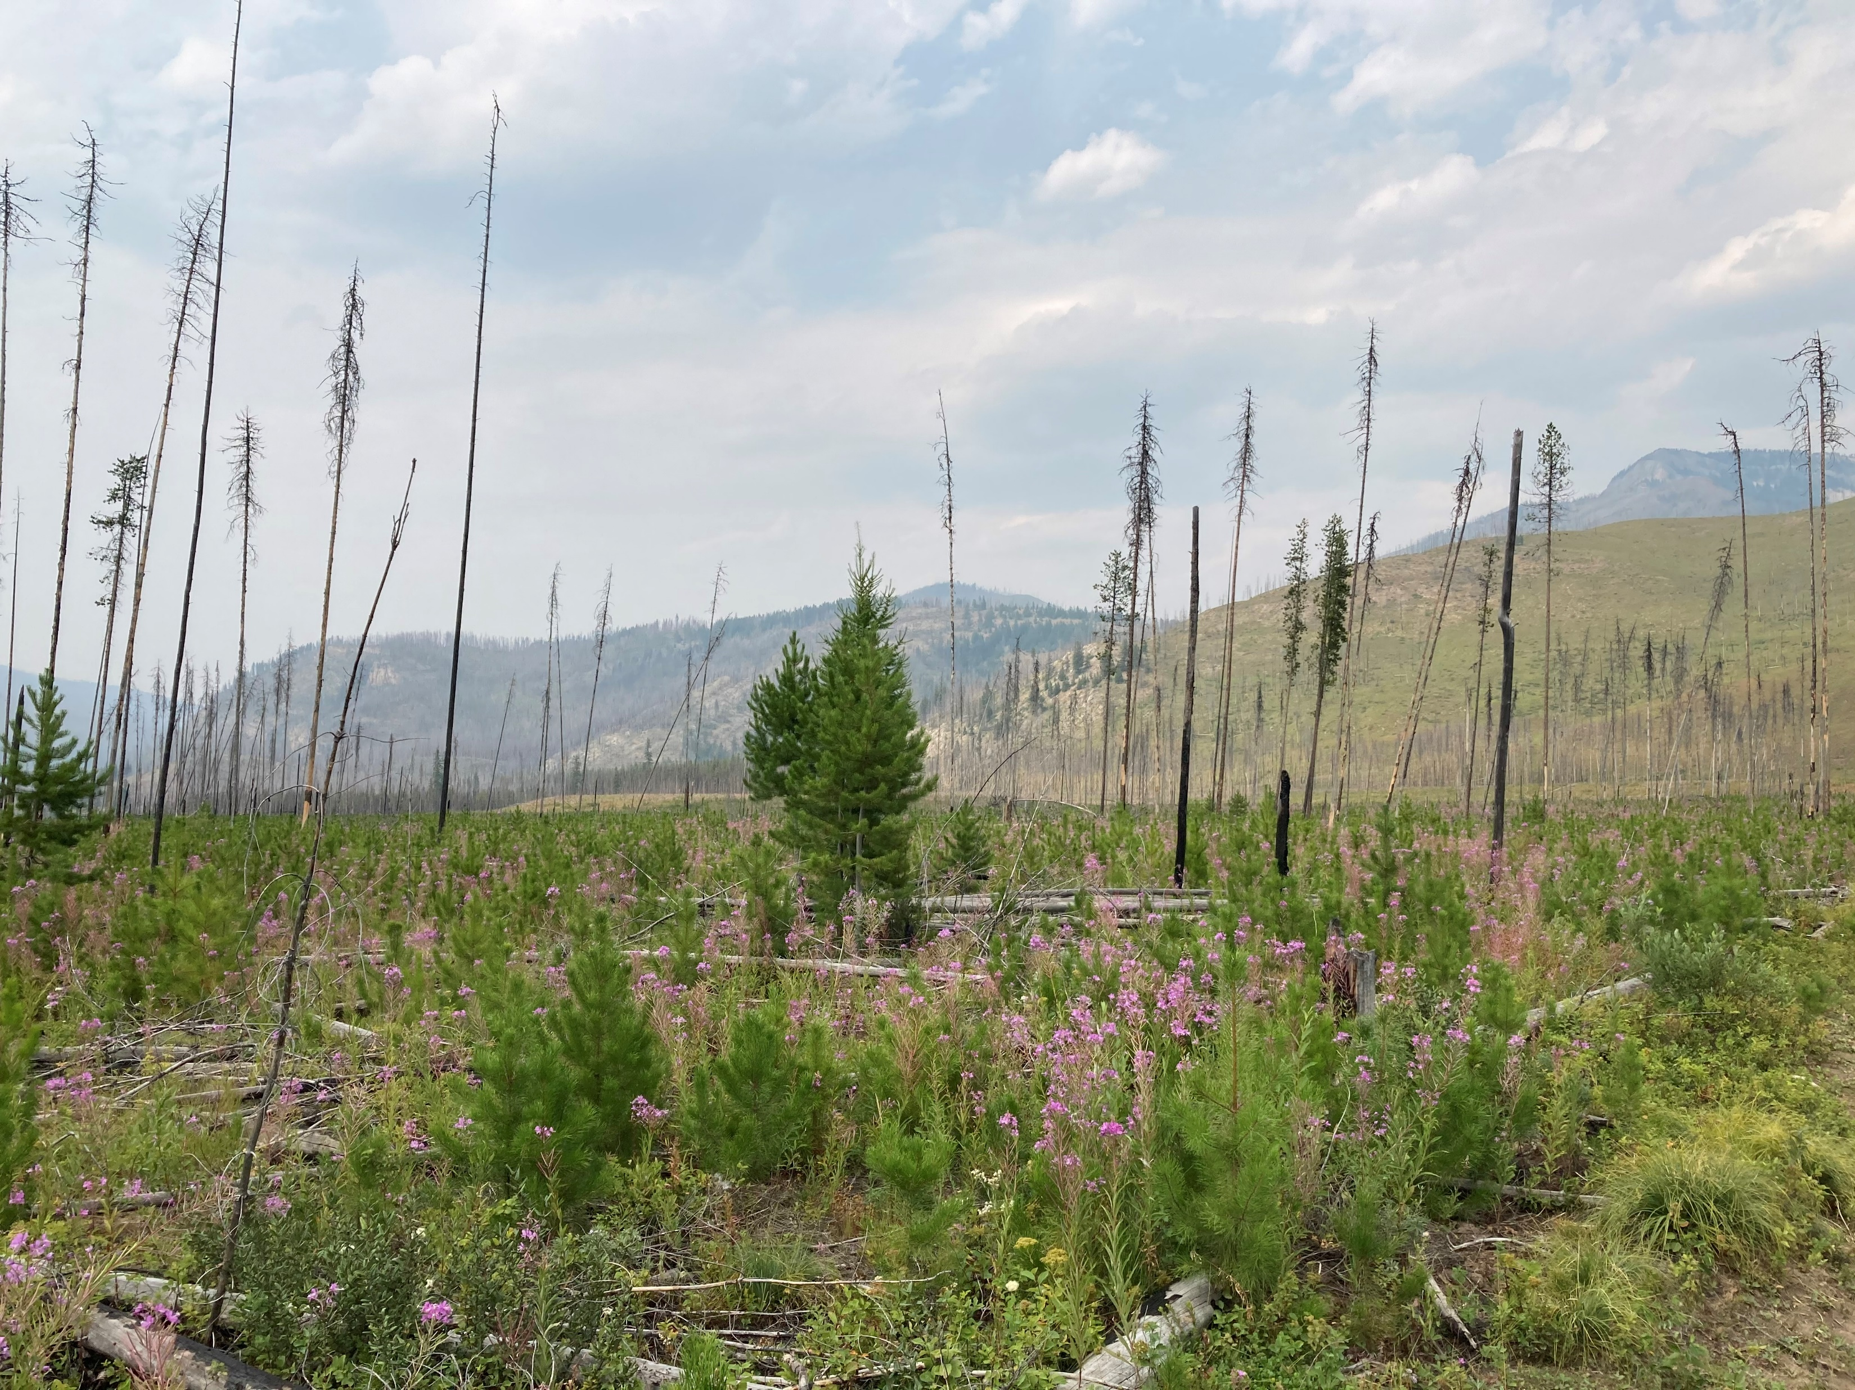
Questions?
For additional questions, feel free to talk with me at the conference or at the email:
jeffrey.chandler435@gmail.com
**I’m also looking for a job**
Credit: Jeffrey Chandler
Notes:
Now for questions, and feel free to catch me at the conference or email me.

Slide 17
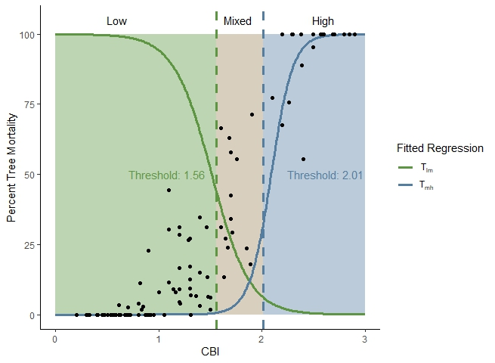
Notes:
Figure 5 Thresholds between CBI and percent tree mortality.

Slide 18
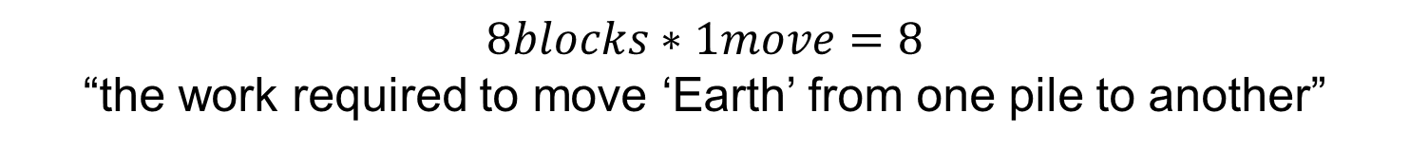
Analyze each using Earth Mover’s Distance
Mass = 1
1 Move
1 Move
1 Move
1 Move
Distance = 1
$$8blocks∗1move=8$$
“the work required to move ‘Earth’ from one pile to another”
Methods
Notes:
Figure 4. Simple conceptual figure for the Earth Mover’s Distance (EMD) computation. Four blocks moved one positions, four blocks moved two positions. If each block “weighs” 1/12 (number of blocks, to represent a probability distribution), then our EMD would be equal to 1 = (1/12)*((4*1)+(4*2))

Slide 19
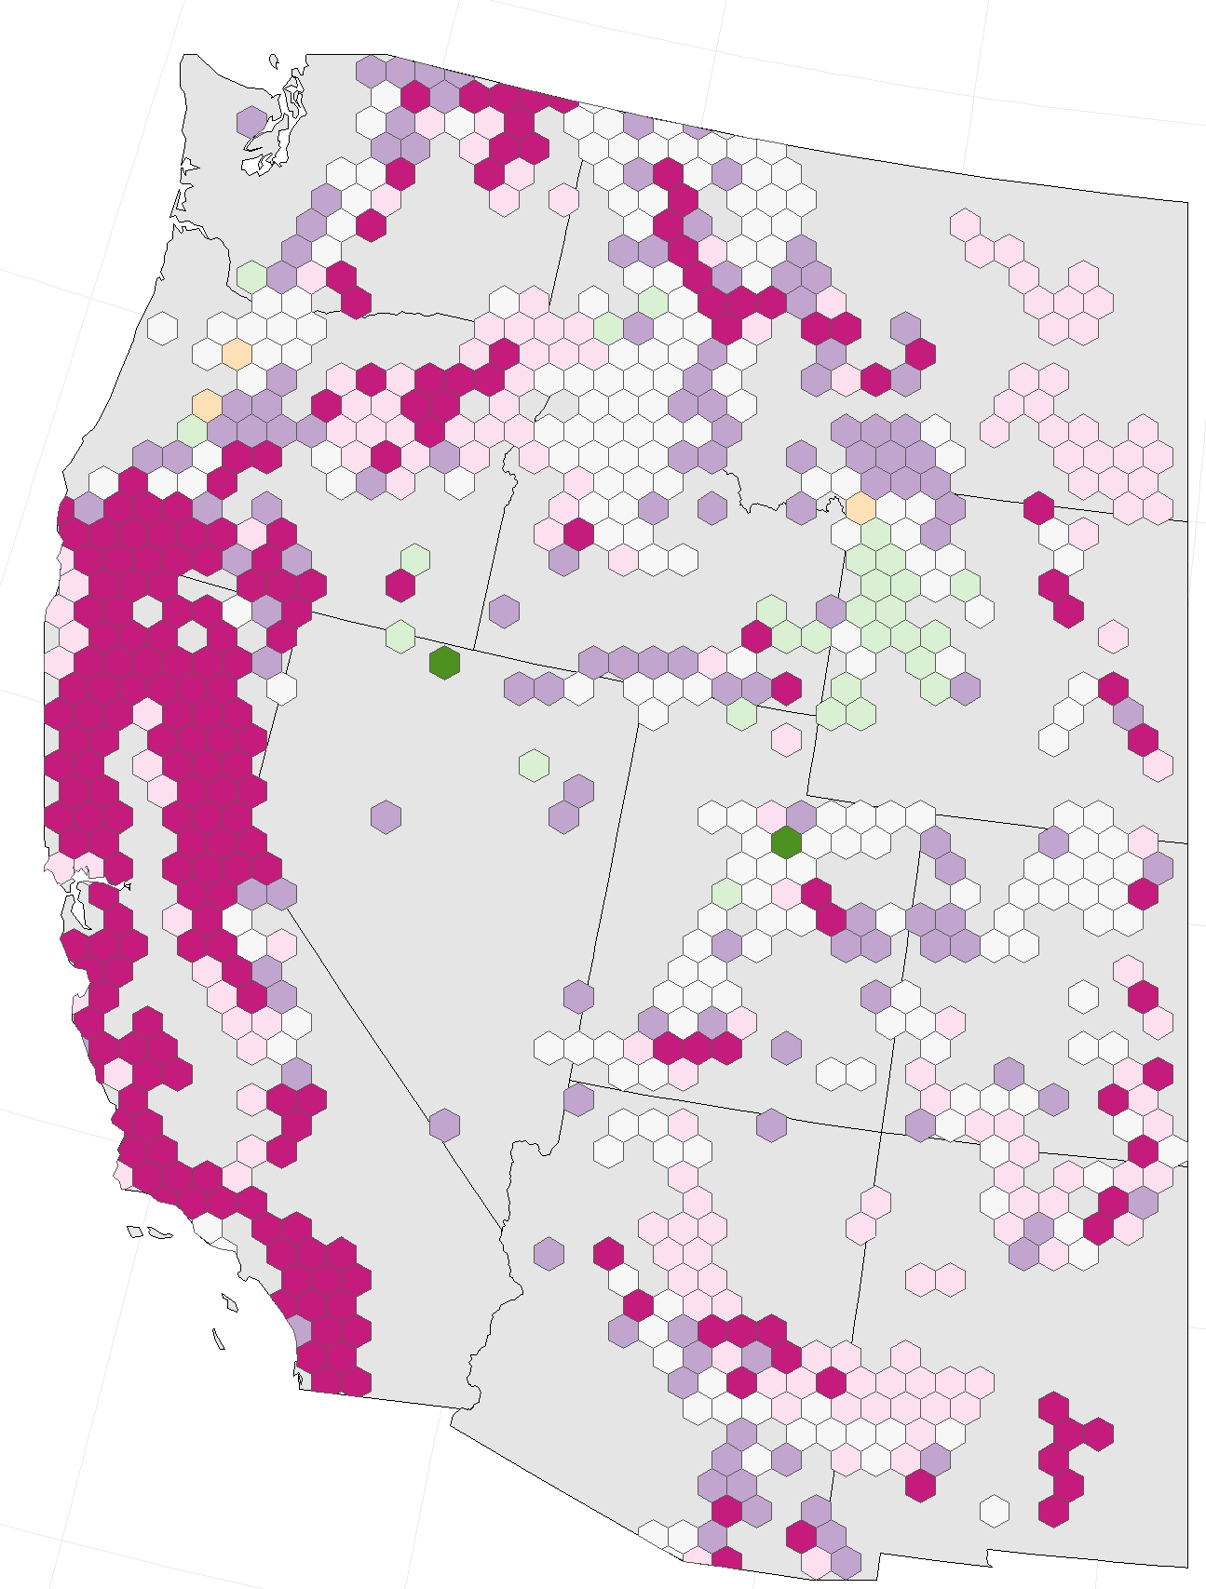
More
Severe
0
Fire Severity
Less
Severe
0
More
Frequent
Less
Frequent
Fire Frequency
Breaks are
absolute 50th
percentiles

Slide 20
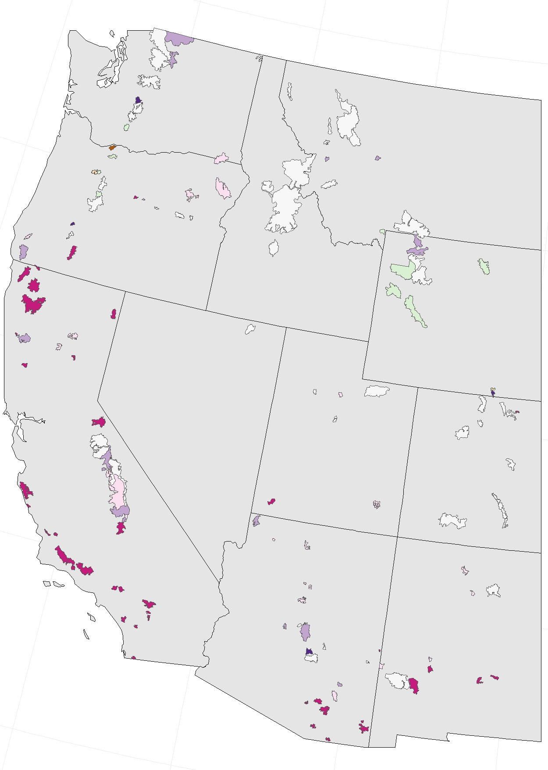
More
Severe
Less
Severe
0
Fire Severity
0
More
Frequent
Less
Frequent
Fire Frequency
Breaks are
absolute 50th
percentiles

